Slide 2
SlantMem
input Cclk,
output s_axis_video_tready,
input [23:0] s_axis_video_tdata ,
input s_axis_video_tvalid,
input s_axis_video_tuser ,
input s_axis_video_tlast ,
Y0
CbCr0
Y0
CbCr0
Y0
CbCr0
Y0
CbCr0
YCbCr[95:0]
{Cr1,Cb1,Y3,Cr1,Cb1,Y2,
Cr0,Cb0,Y1, Cr0,Cb0,Y0}
RGB[95:0]
{R3,B3,G3, R2,B2,G2,
R1,B1,G1, R0,B0,G0}
YcbCr
2
RGB
input Hclk,
input HVsync ,
input HMemRead,
input pVDE ,
output [23:0] HDMIdata

Slide 3
FraimSync 1
Not saved in input; 0 (black pixel) at Output
tdata
Dpl
Dl
D0
D1
D2
D3
D4
Saved in input; pixel at Output
tvalid
tuser
FraimSync 1
Save Data 1
tlast
FraimSync
FraimSync 0
Save Data 0
Add_odd
Not Saved
Saved
FraimSync 0
FraimSync 1
Save Data 1
tdata
Dpl
Dl
D0
D1
D2
D3
D4
tvalid
tuser
tlast
FraimSync
Add_odd
Saved
Not Saved

Slide 4
Not saved in input; 0 (black pixel) at Output
Saved in input; pixel at Output
FraimSync 1
Save Data 1
FraimSync 0
Save Data 0
FraimSync 1
Save Data 1

Slide 5
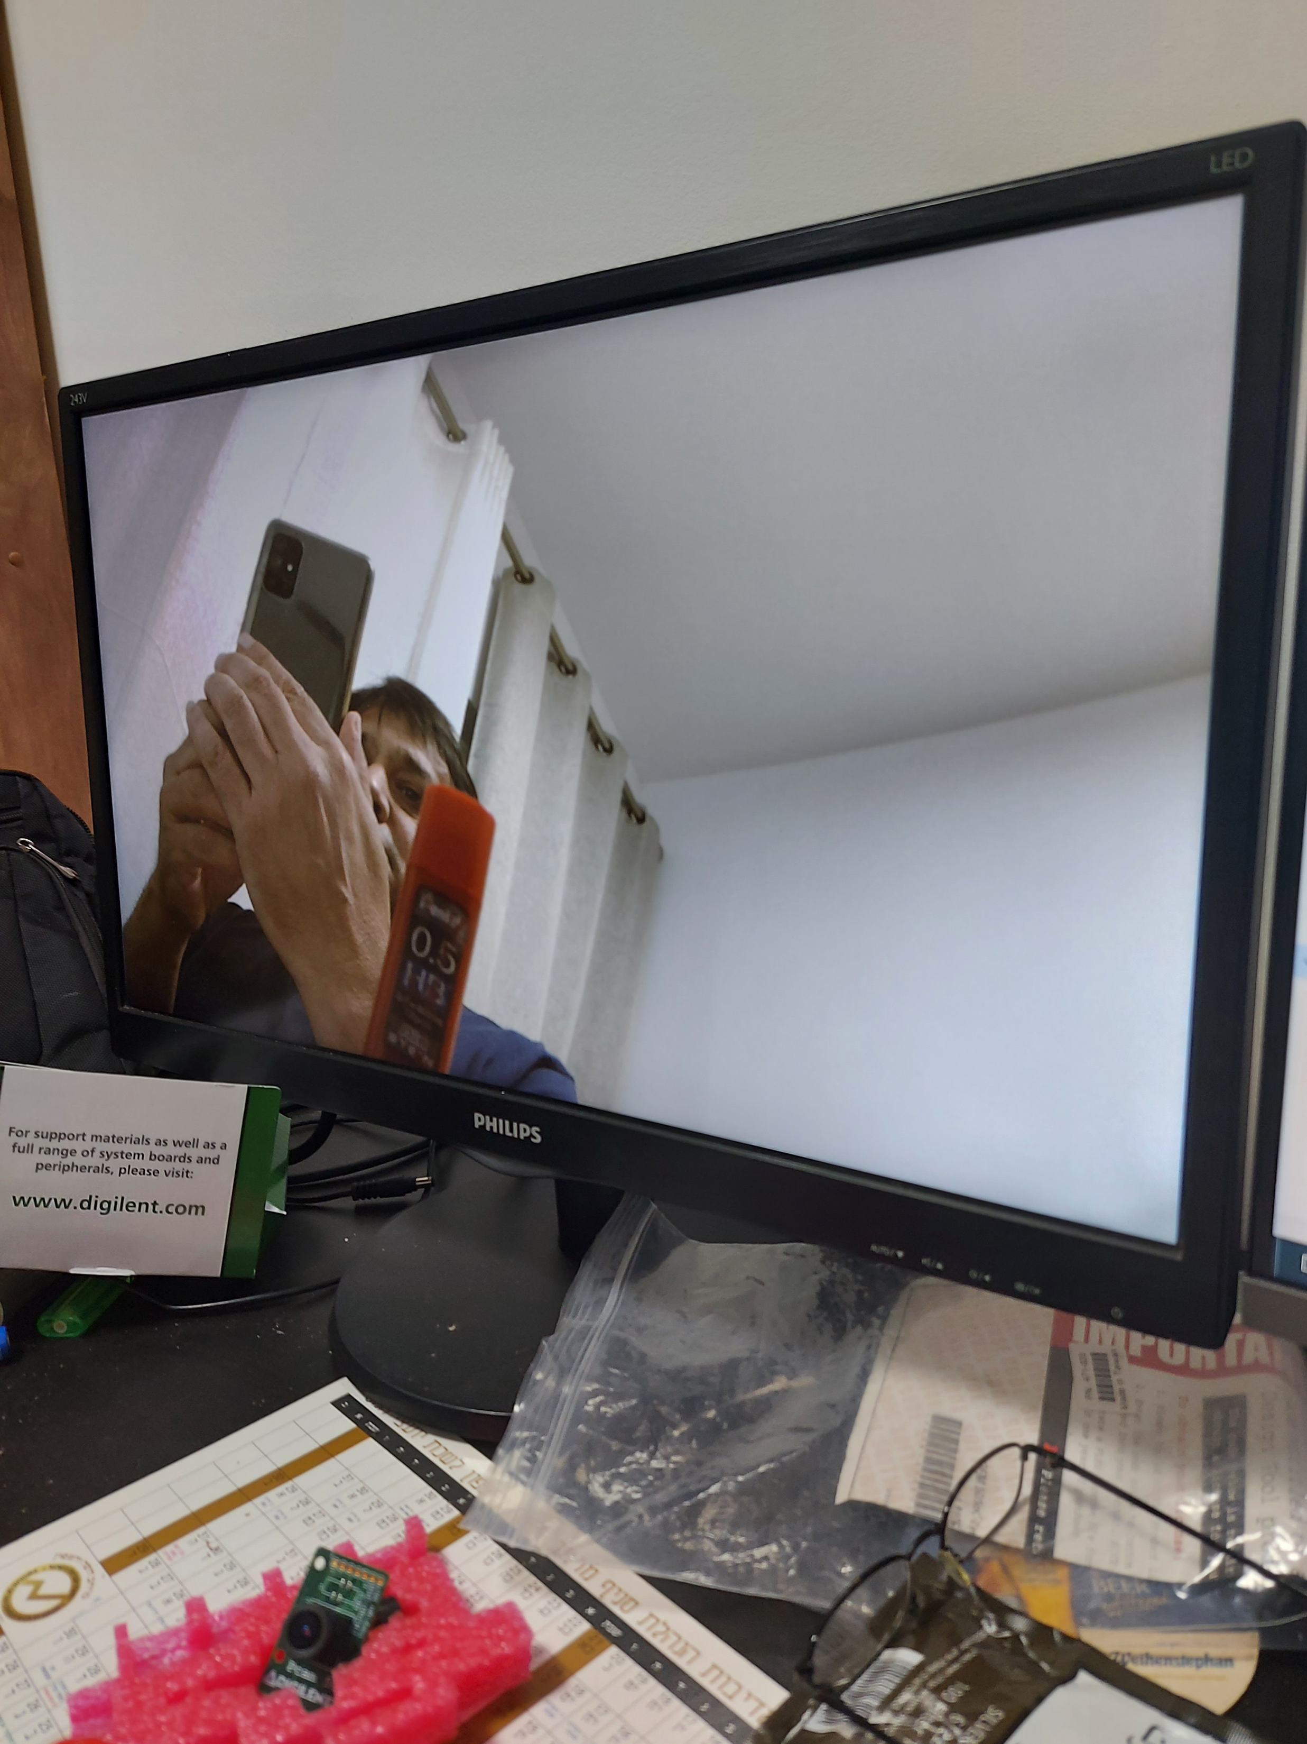
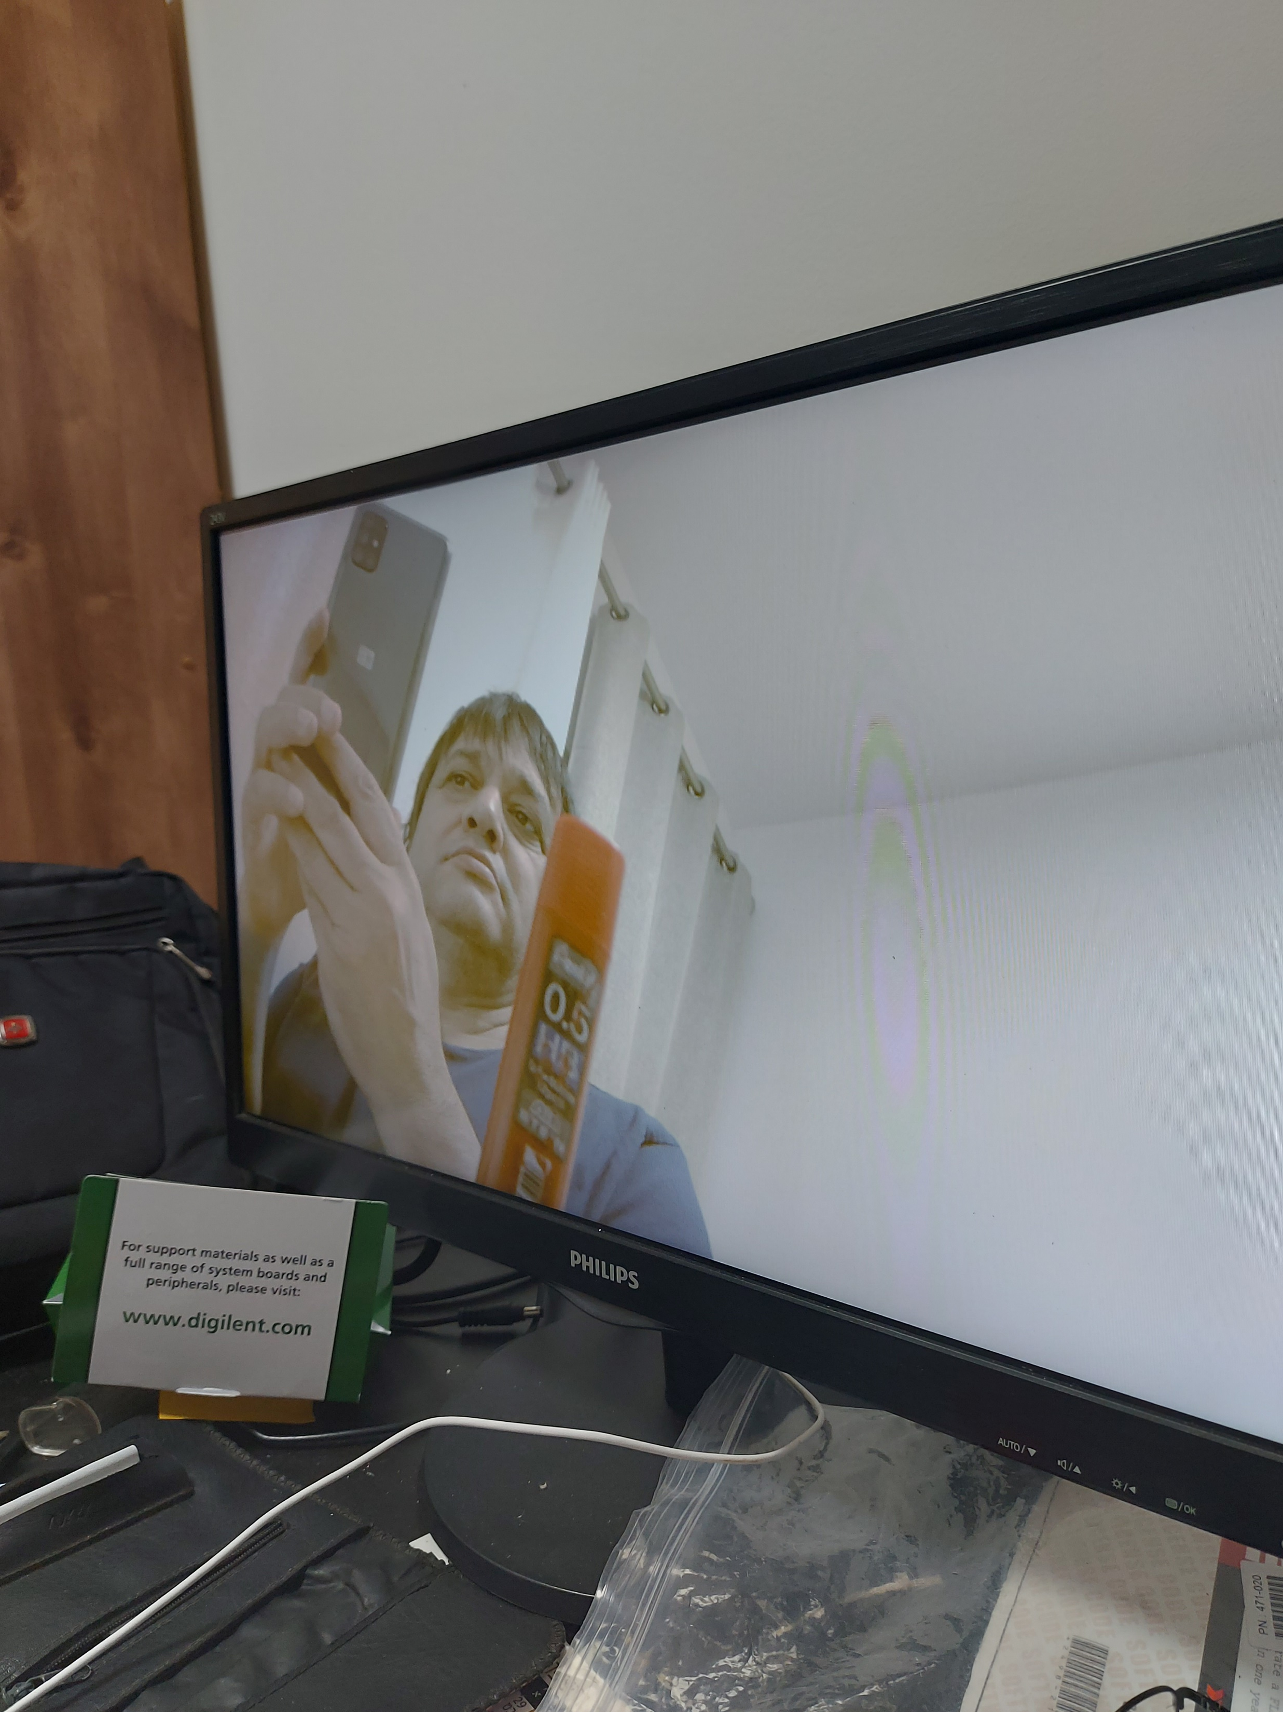

Slide 6
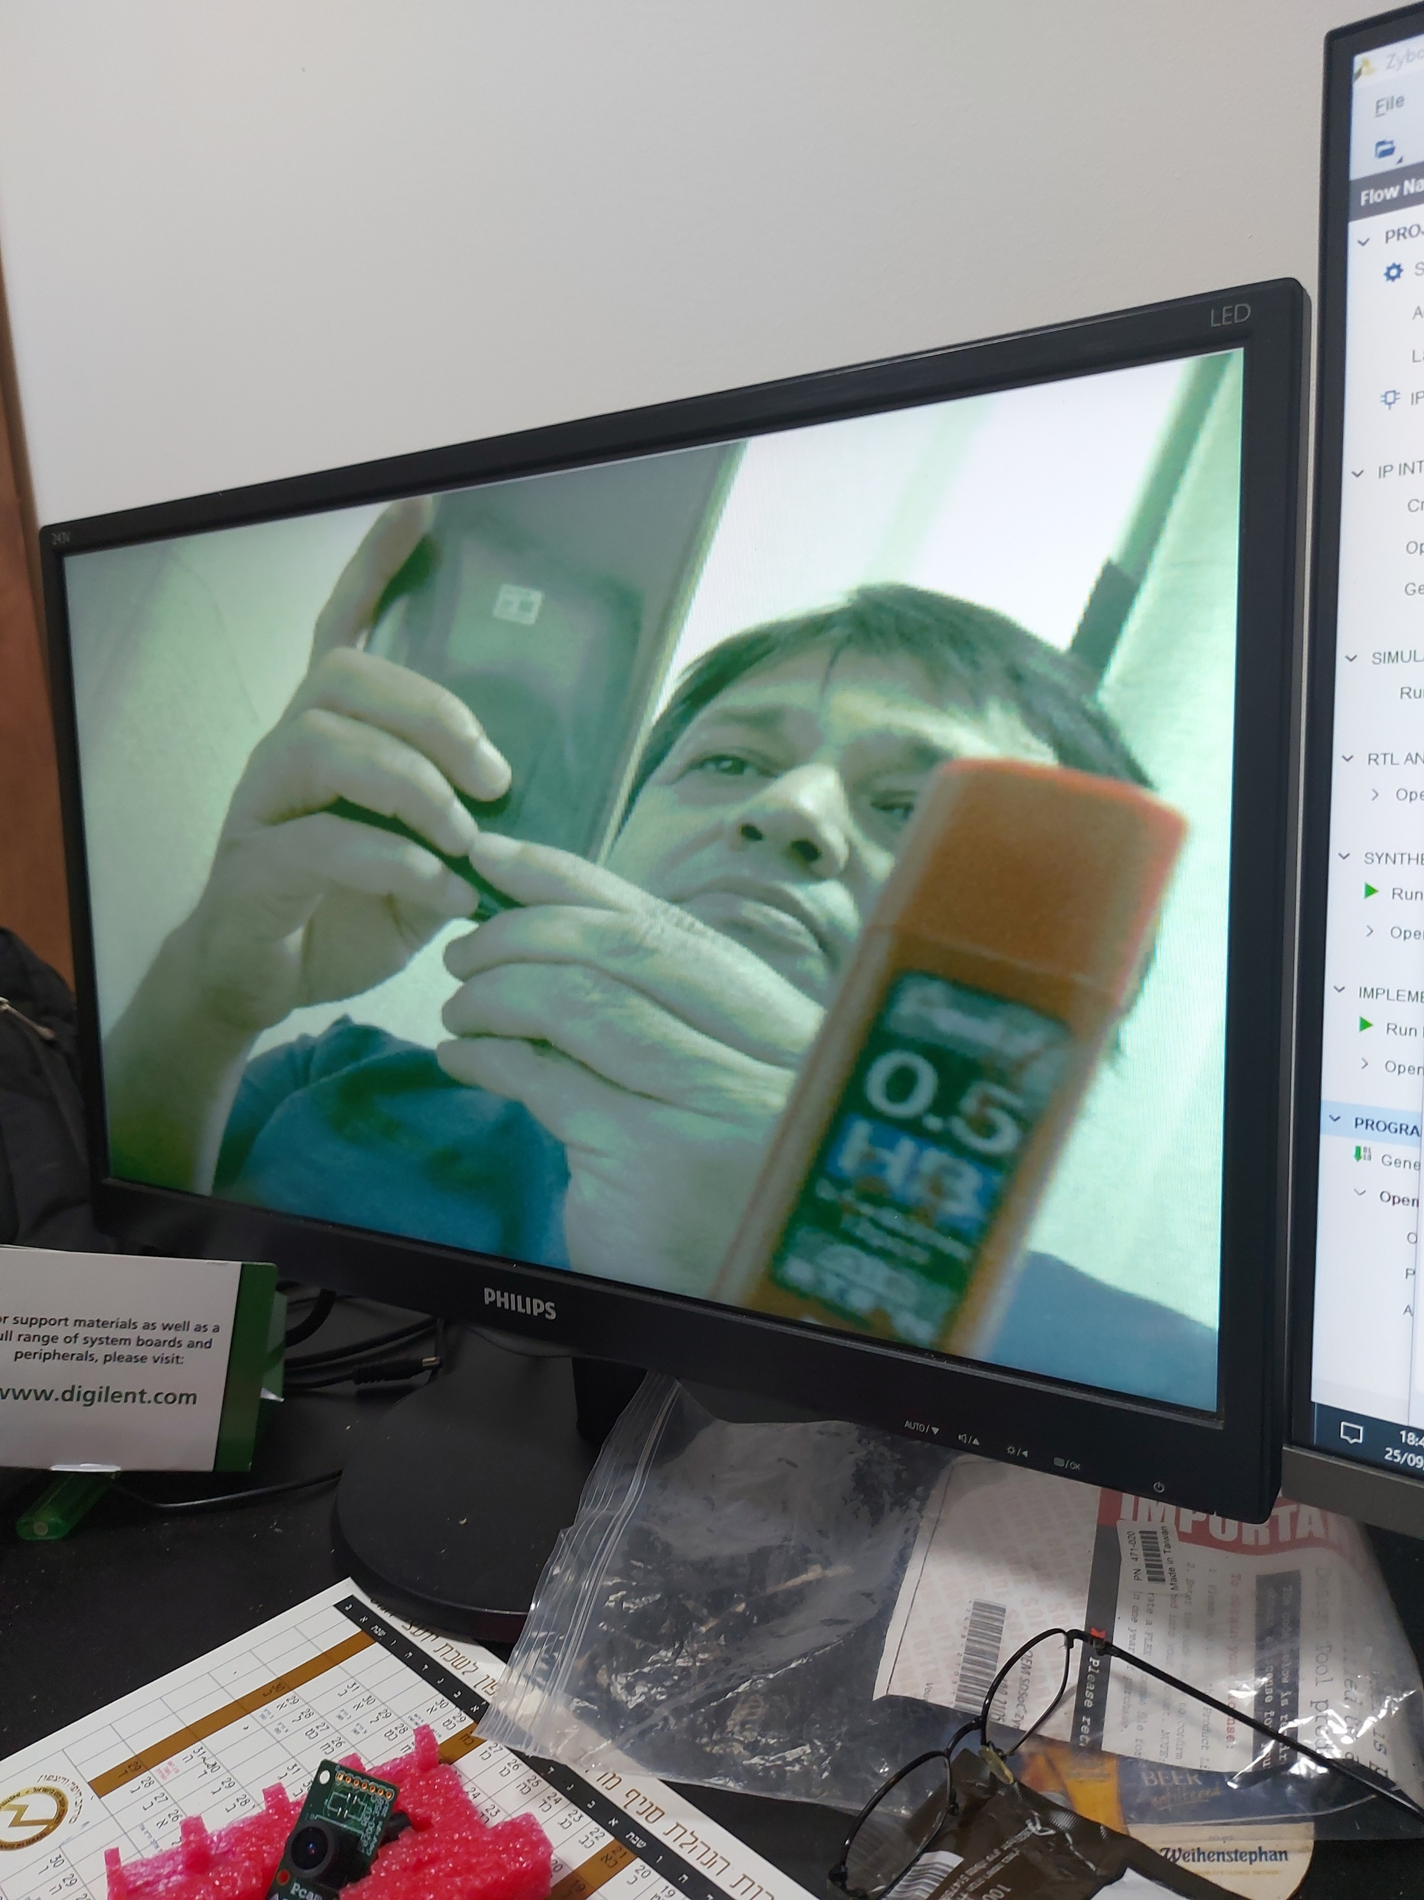
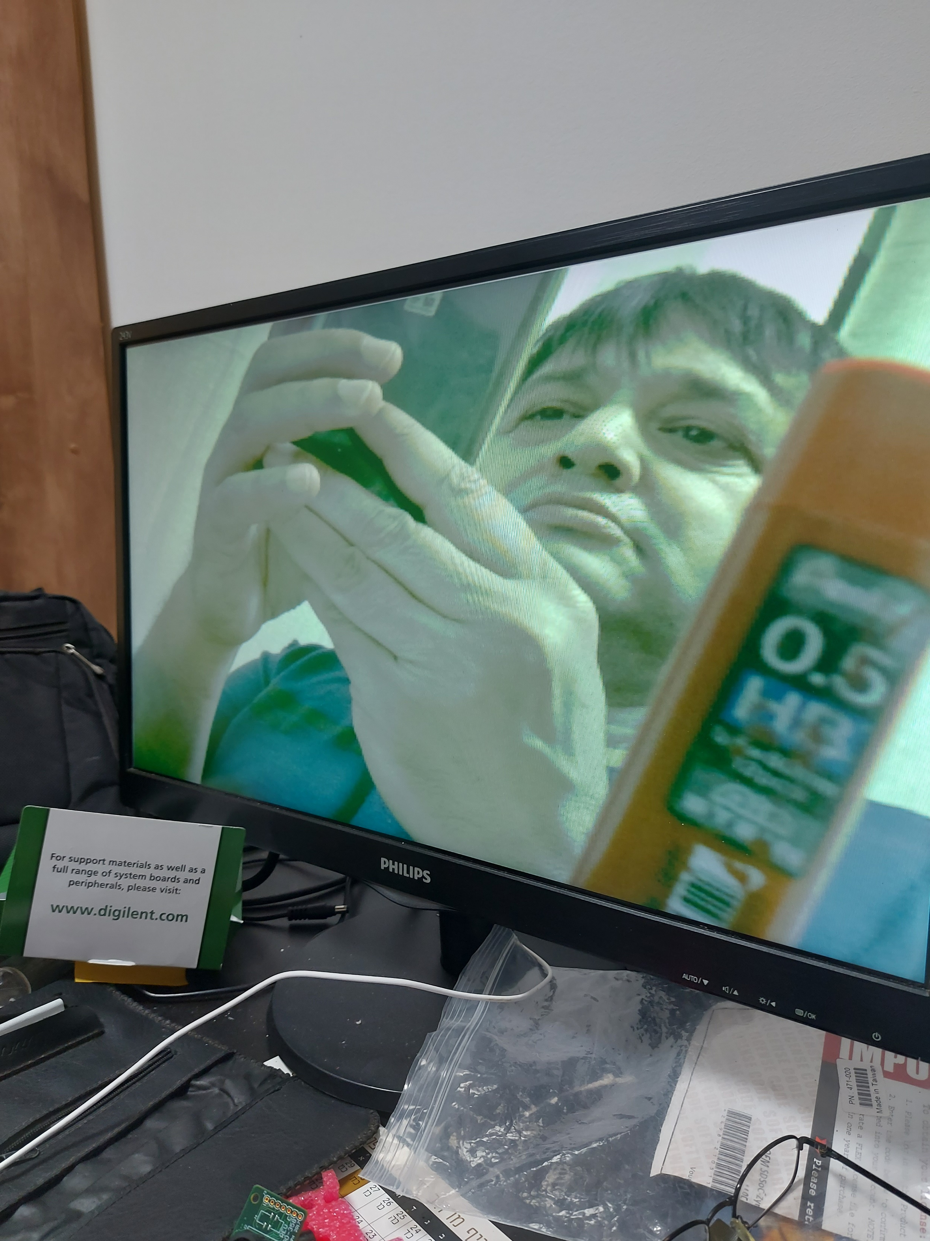

Slide 7
Original
1280x720;30fps
Original
640x480;60fps

Slide 8
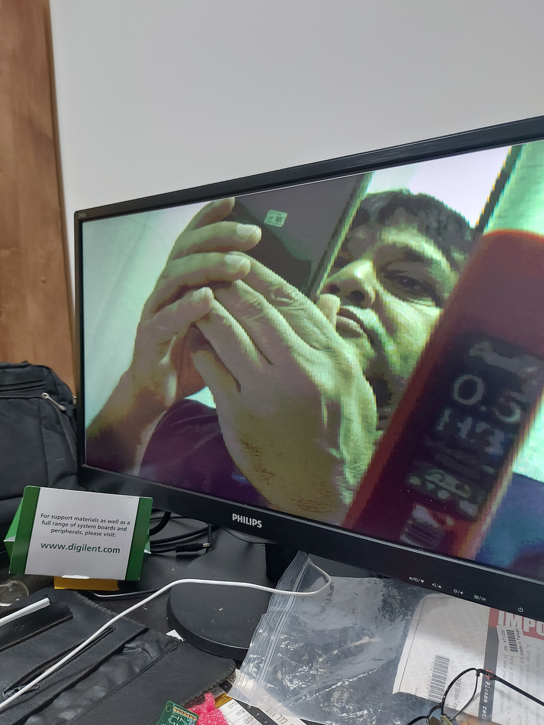
RGB444
640x480;60fps
Original
640x480;60fps

Slide 9
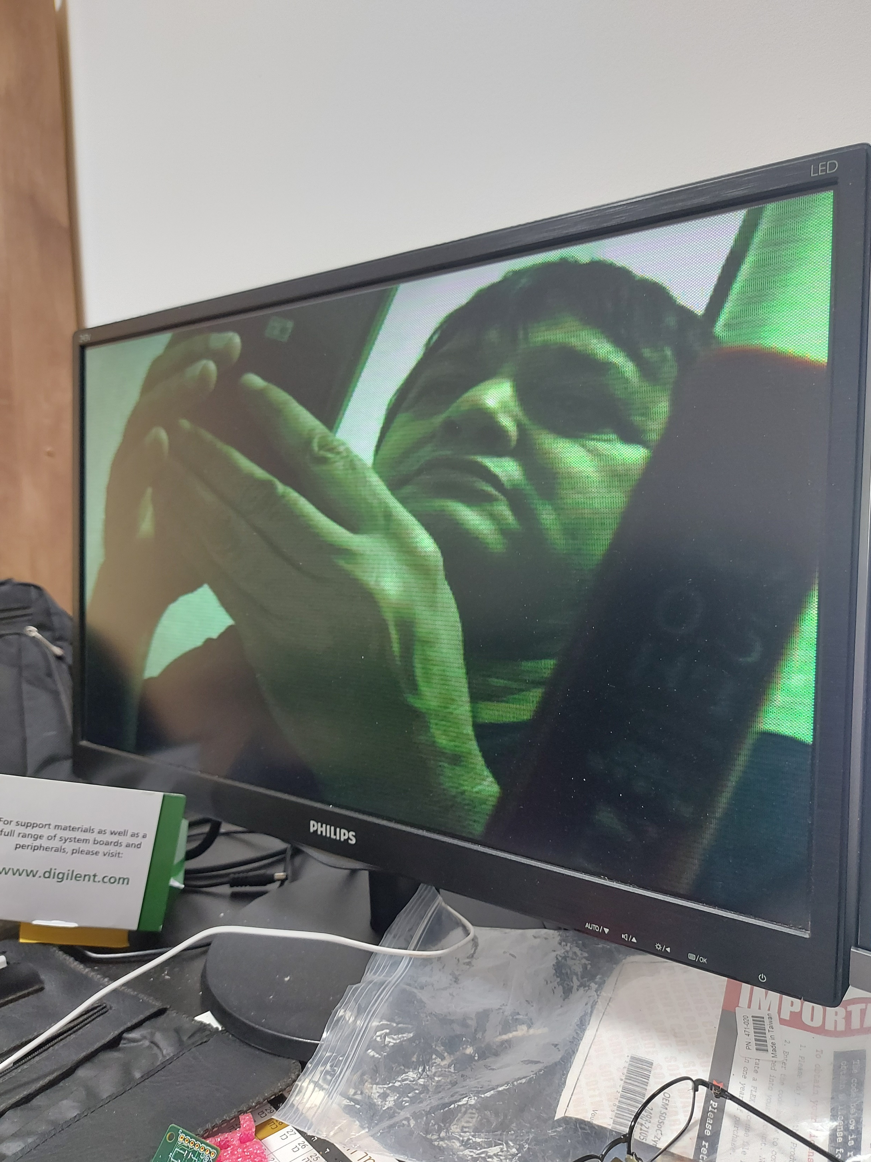
YCbCr5554:2:2
checkmath
640x480;60fps
Original
640x480;60fps

Slide 10
YCbCr5554:2:2
checkmath
640x480;60fps
RGB444
640x480;60fps

Slide 11
Original
1280x720;30fps
Original
640x480;60fps

Slide 12
RGB444
640x480;60fps
Original
640x480;60fps

Slide 13
YCbCr5554:2:2
checkmath
640x480;60fps
Original
640x480;60fps

Slide 14
YCbCr5554:2:2
checkmath
640x480;60fps
RGB444
640x480;60fps

